Slide 1

2024©
Connect 4 Game in Python
LASNIER - LAZREG – POILVE
Applied System Software

Slide 2
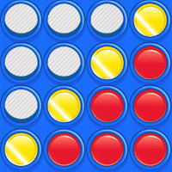
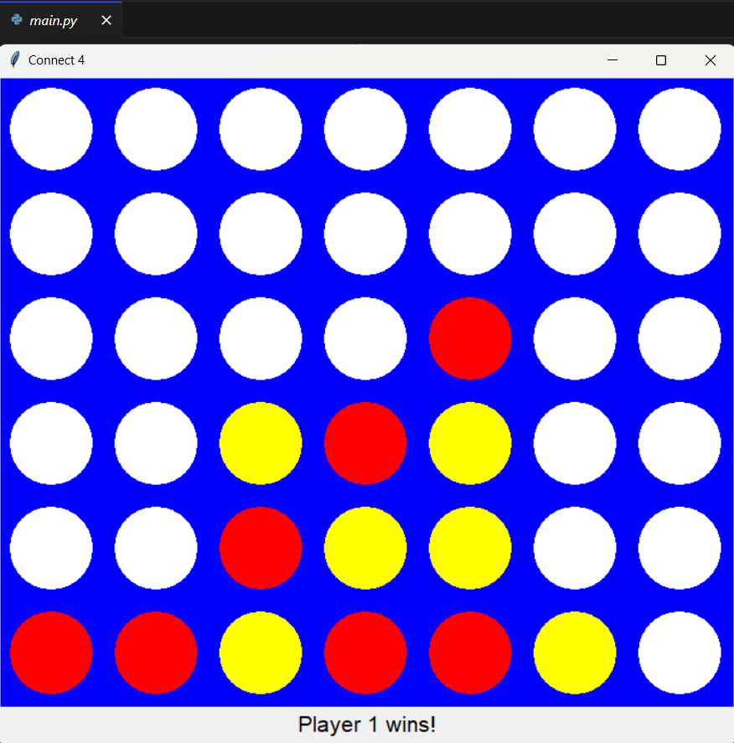
Project presentation
Goal: a Connect 4 video game coded in Python with a simple interface, with instructions on how to use the computer program.
Some Requirements:
Easy to use
2 players
2 discs color + blue grid
Fast with no bugs
Rules respected
Adaptable code

Slide 3
Agenda
1. Report 2.GitHub 3.Presentation
Software Requirements / Analysis
Black-Box Testing / Test Cases
Design
Software Design
Implementation
Testing

Slide 4
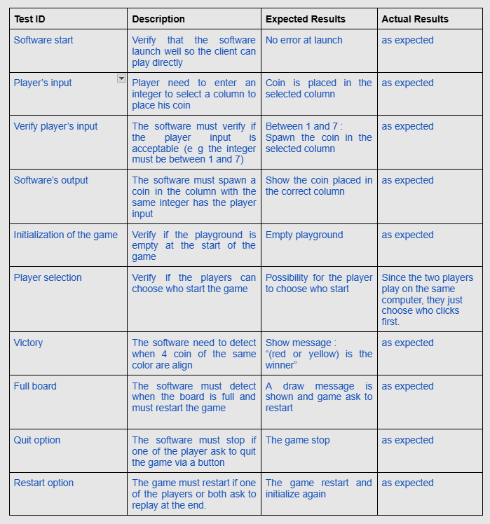
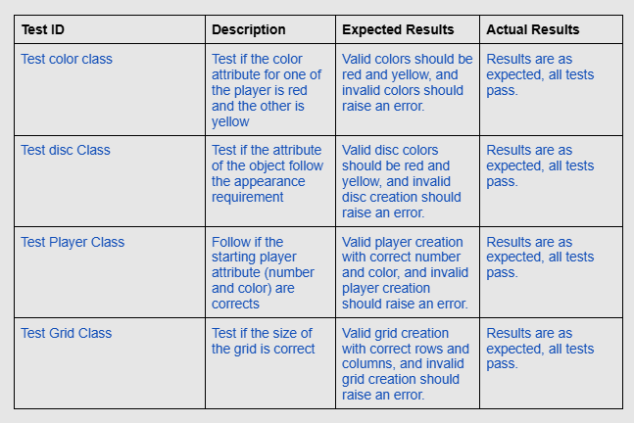
Black box testing

Slide 5
Design -> choice of structure
Design 1
Design 2
Game :
Attributes : Player 1, Player2, Current player, Winner, Game status
Player :
Attributes : Name, Color
Disc :
Attributes : Color, Position
Grid/Board :
Attributes : Sizes, Layout
Position :
Attributes : row, column
Game :
Attributes : Player1, Player2, Current player, Winner, Game status
Methods : Turn(), grid(), WinCheck()
Grid :
Attributes : Sizes, Layout
Colors :
Attributes : PlayersColors, DiscColors

Slide 6
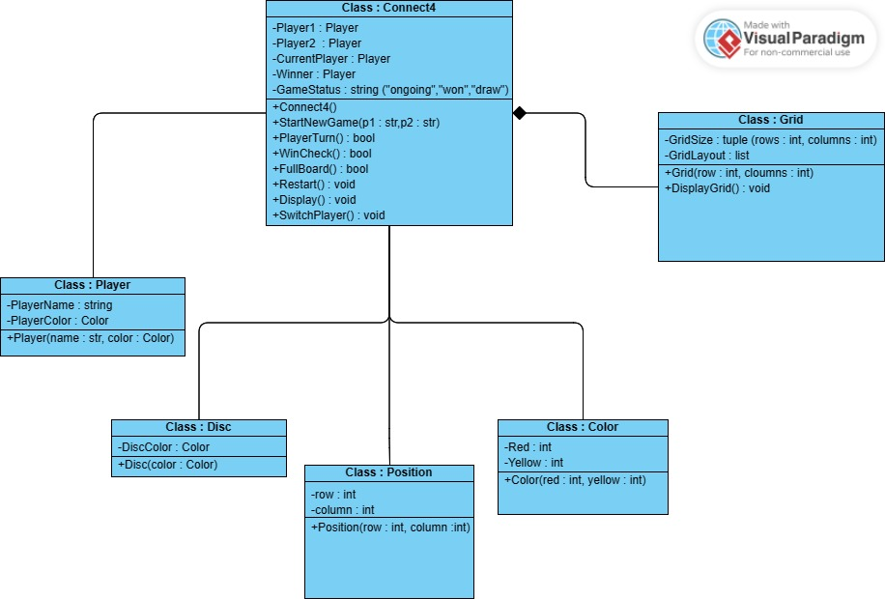
Software Design
UML class diagram :
Class :
Connect4
Player
Grid
Disc
Position
Color

Slide 7
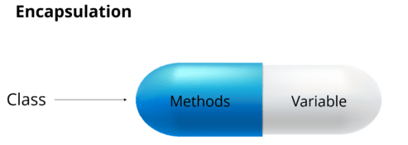


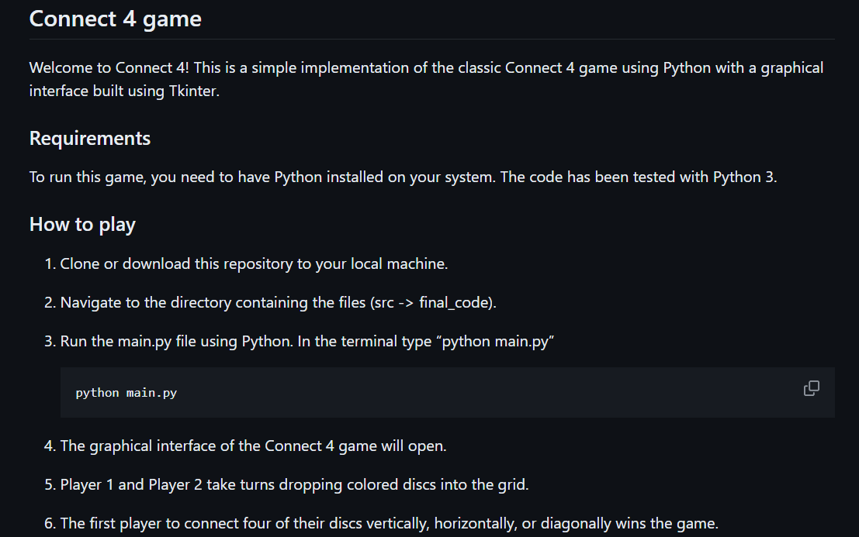
Implementation
Programming concepts used :
user input/output
Object Oriented Programming
Conditional statements
Composition (to represent relationship between our classes)
Event handling (to spawn a coin when the player clicks)
Encapsulation
+ Documentation (ReadMe)

Slide 8
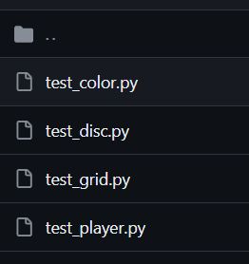

Tests of the game
4 files

Slide 9
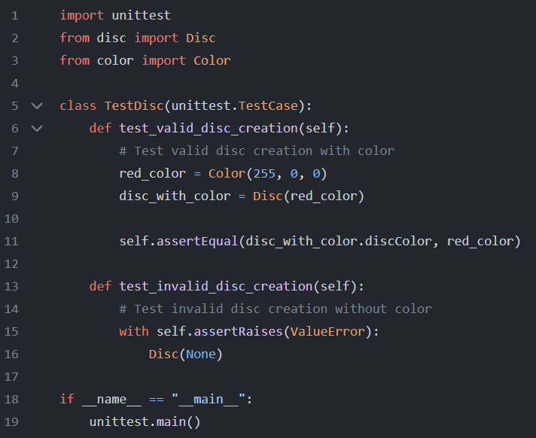
Screenshots :
Disc class test :

Slide 10
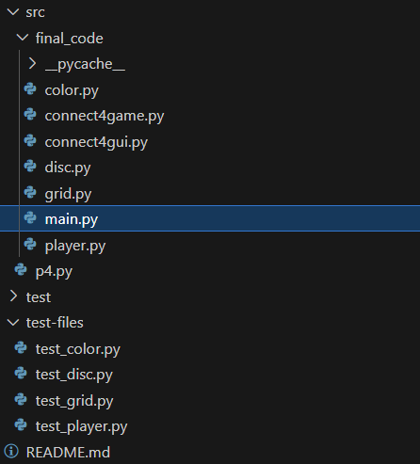
Demo of Alpha and Release version
Code Tree

Slide 11
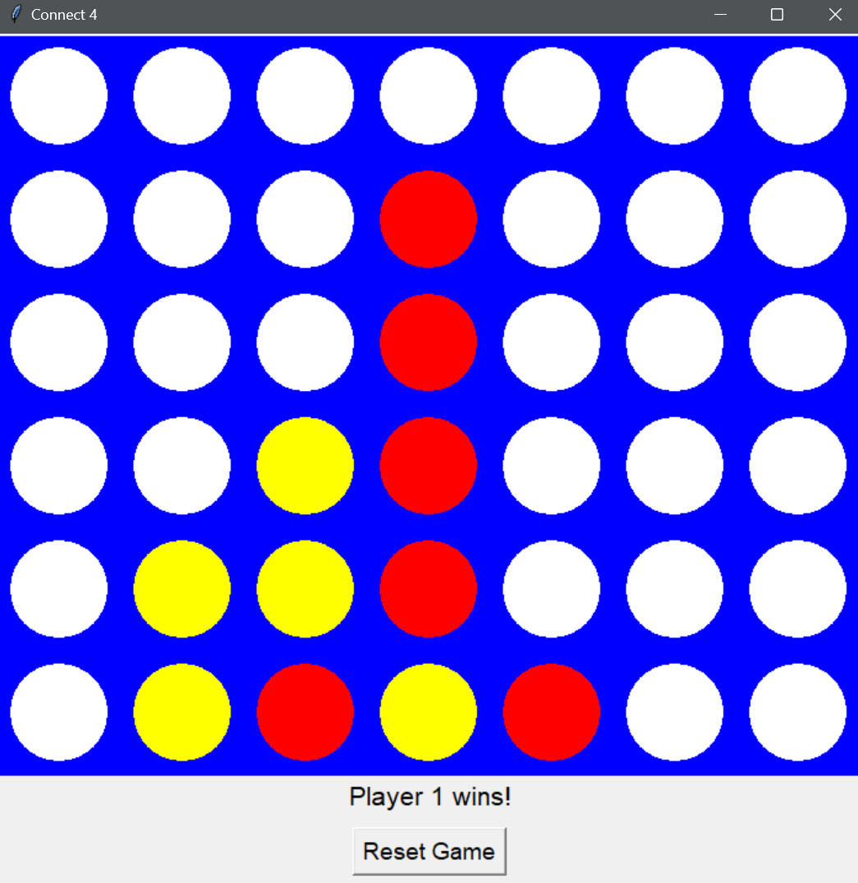
Screenshots :
Game window :

Slide 12
Repartition (7 à 10min)
Mehdi : Presentation(2), Design(5), testing(8)
Aurélien : Software design(6), implementation(7), je peux expliquer la slide avec le testing code de disc aussi.
Alexandre : Agenda( 3), Blackbox(4)
Demo = a little bit of us all

